Slide 1
Calgary: Sites and Hoods (A guide for newcomers)

Slide 2
Business Idea:
For my data science Capstone Project, I am using the Foursquare API and the openly available Wikipedia location data, to explore the City of Calgary, Alberta, within which I reside. As a newcomer to the City of Calgary, I was unclear about the best residential locations with access to relevant facilities. By performing this project, I am creating a platform for other newcomers to have a high level perspective of the distribution of the neighborhoods and locations of interests within Calgary, to help with smooth settlement.
Methodology:
The following work flow has been applied for this project:
-Extraction, exploration and clean-up of neighborhood data from Wikipedia
-Obtaining the surrounding venues from Foursquare API
-Analyzing the venue distribution for each neighborhood
-Apply K-Means to group neighborhoods into clusters
-Visualizing clusters on Map with Folium

Slide 3
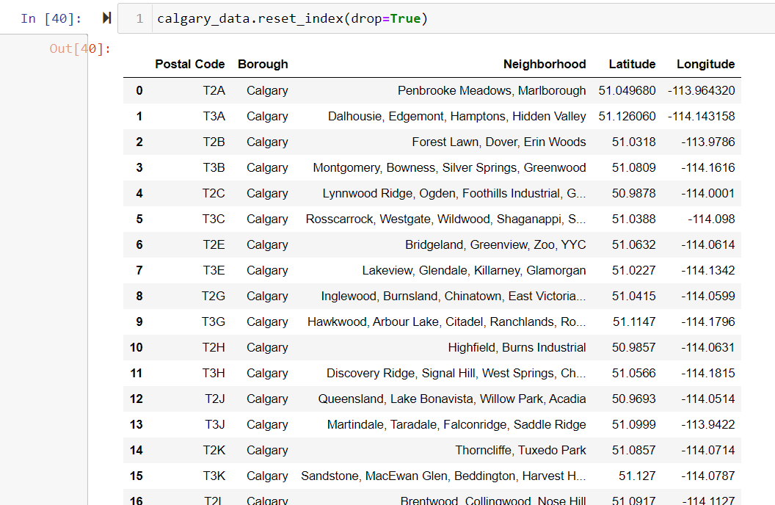
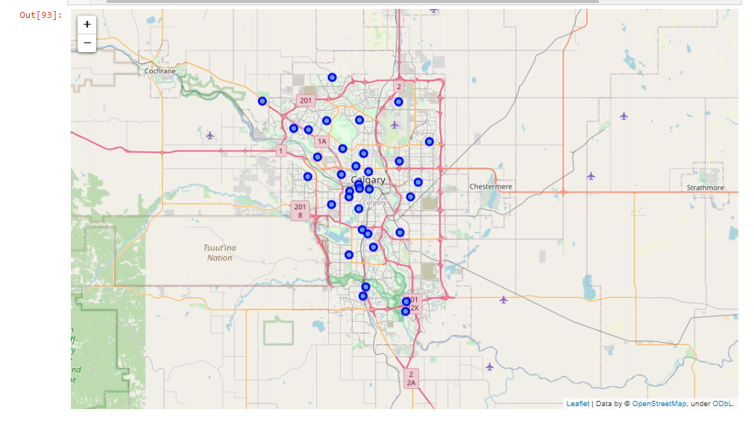
Results:

Slide 4
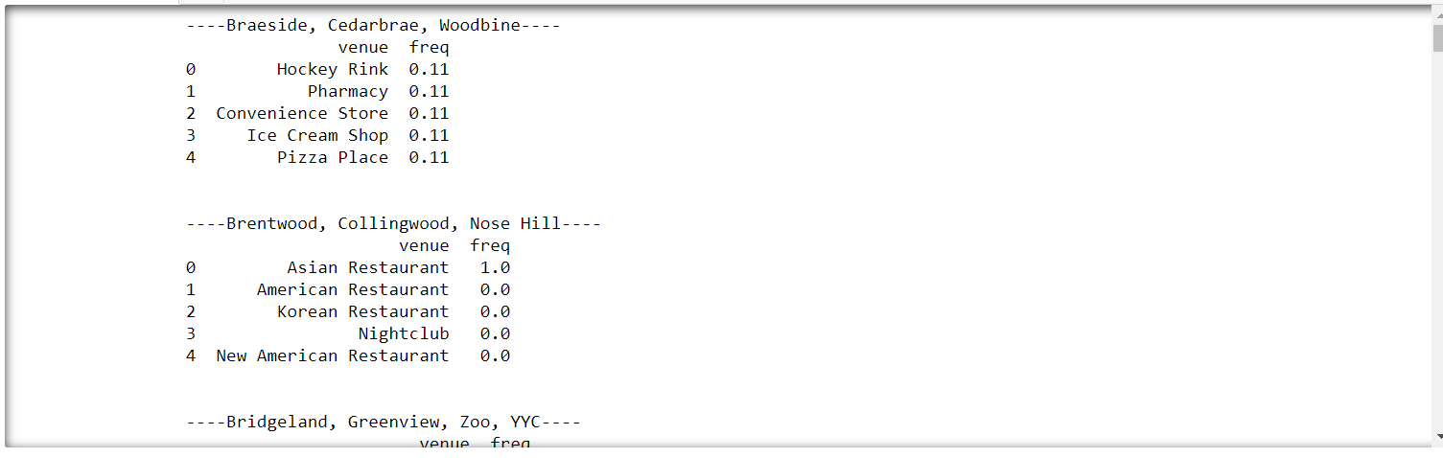
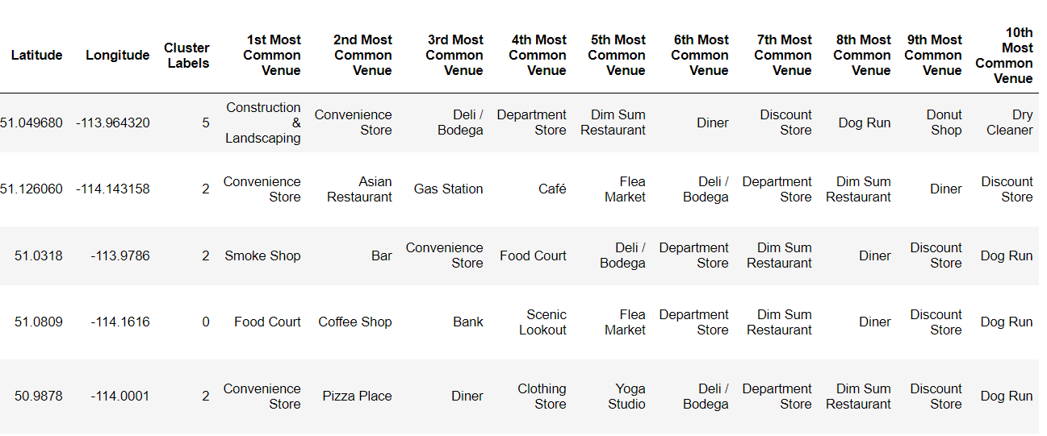

Slide 5
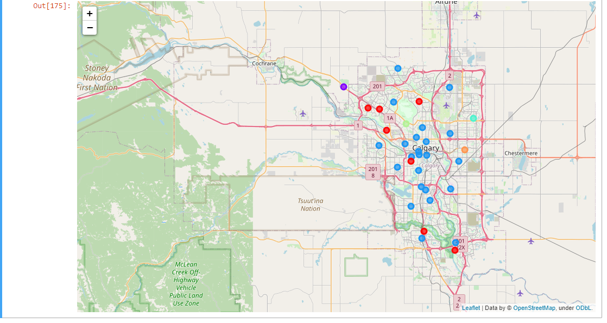

Slide 6
Conclusion: With this detailed analysis, any newcomer to Calgary can have a high level view at the distribution of neighborhoods (as well as their similarities), within the city.

